Slide 1
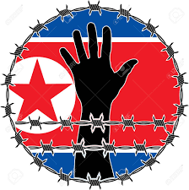
HUMAN RIGHTS IN
NORTH KOREA
BY:NAJAM ALI ABASS

Slide 2
INTRODUCTION
MOST REPRESSIVE COUNTRY
WORST FORM OF GOVERNMENT
DICTATED BY KIM JONG UN
VIOLATION OF HUMAN RIGHTS

Slide 3
HUMAN RIGHT VIOLATION Economic life
The North Korean government does not guarantee its people's basic living conditions and is starving them to death
The greatest human rights violation of all is the starvation of millions of workers
Taken The right for the survival of their people

Slide 4
Violation In Political life
Party bureaucracy and human rights violations
North Korea is a lawless land where laws are for show
Discrimination according to class and guilt by association

Slide 5
IDEOLOGICAL LIFE
Absolutism of the Great Leader destroys love and morals
Cultural policies to keep the people ignorant
Turning people into slaves of ideology

Slide 6
THE END

